Slide 1
Why is good mental health important and what can we do to improve our mental health?

Slide 2
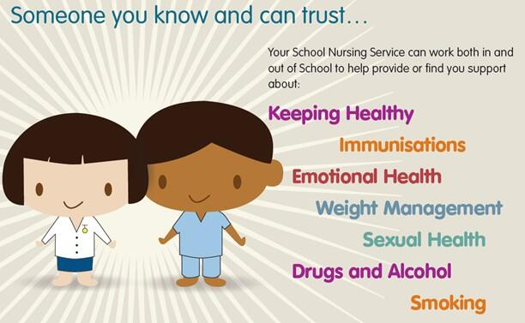
School Nursing Service
Notes:
Introduce self and welcome the group.
Advise the group that if they have any questions to put up their hands.
About School Nursing:
Our school Nursing team aims to support children and young people from 5 to 19 years and their families reach their full potential.
The school team consists of qualified nurses with some nurses having completed specialist training in public health. We are employed by the NHS and based at Wood End Park Clinic and go in to schools to see children and young people.
We deliver school nurse drop in clinics and can offer information and support in the following areas;
Emotional health and well-being
Managing complex and additional health needs
Monitoring growth and development – hearing and vision and NCMP in primary school.
Support with growing up and preparing to become an adult
Bridging the gap between health and education.
Health Promotion-oral health, personal hygiene and puberty
Safeguarding – domestic, sexual, physical abuse and neglect, bullying, special educational needs, drugs and alcohol misuse.
We provide a confidential service. This means that you can discuss personal information in confidence. We will not discuss your personal information with anyone else without your permission. This includes parents and teachers. We would only pass on your information in order to protect you or someone else from serious harm.
Whenever possible we would discuss this with you first.

Slide 3
What is Good Mental Health
Mental health is “a state of well-being in which the individual realises his or her own abilities, can cope with the normal stresses of life, can work productively and fruitfully, and is able to make a contribution to his or her community”. The person can understand the world around them and they are able to take part in every part of their life’s activity without concern.
Notes:
Today’s session is about the importance of good mental health:
Ask the group the question:
What is good mental health? Then put the slide up in the background.
Allow the group to offer answers. Everyone has part of the answer and together we have the full answer.
Answers to look out for:
Enjoying life
The ability to access school and education
Enjoyment in playing
Socialising and spending time with friends and family.
Having the ability to do everything without stress and upset
The ability to accept change
Having a degree of resilience in which you can overcome problems.
Feeling Happy, calm and able to cope with challenges.
Then read out the definition on the presentation.
In many ways, mental health is just like physical health: everybody has it and we need to take care of it.
Mental wellbeing is about feeling good about yourself, the people around you, and the world itself.
Looking after and feeling good in your mind
Note: The things young people value, enjoy or are good at can all support mental wellbeing. Positive relationships, eating and sleeping well can also be beneficial.
Good mental health means being generally able to think, feel and react in the ways that you need and want to live your life. But if you go through a period of poor mental health you might find the ways you're frequently thinking, feeling or reacting become difficult, or even impossible, to cope with. This can feel just as bad as a physical illness, or even worse.

Slide 4
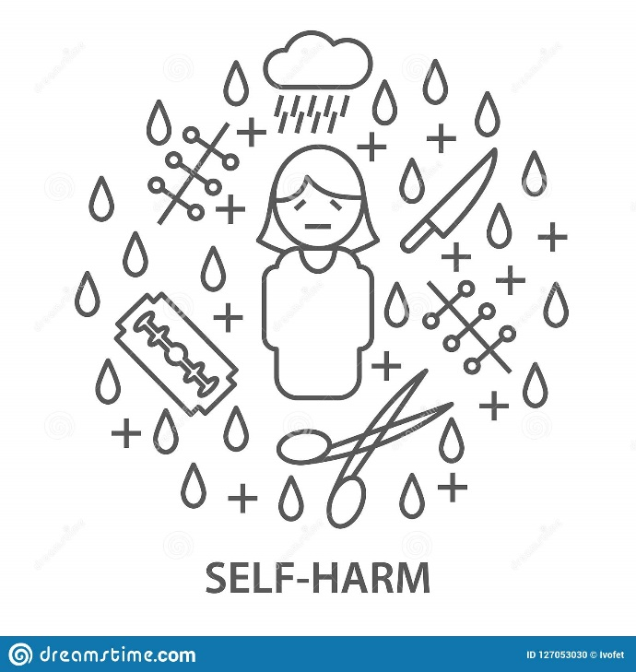
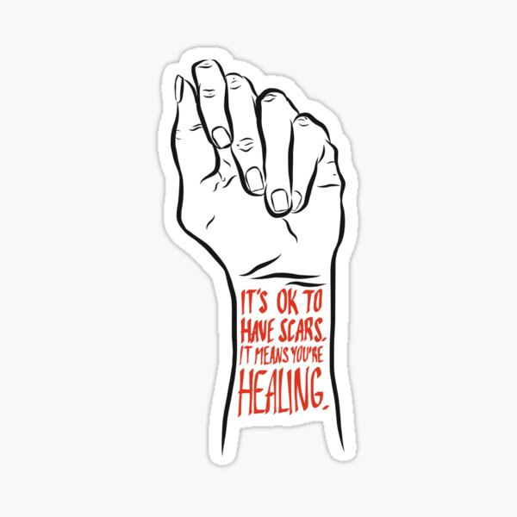
Self-Harming
Is a common mental health presentation in children and young people.

Slide 5
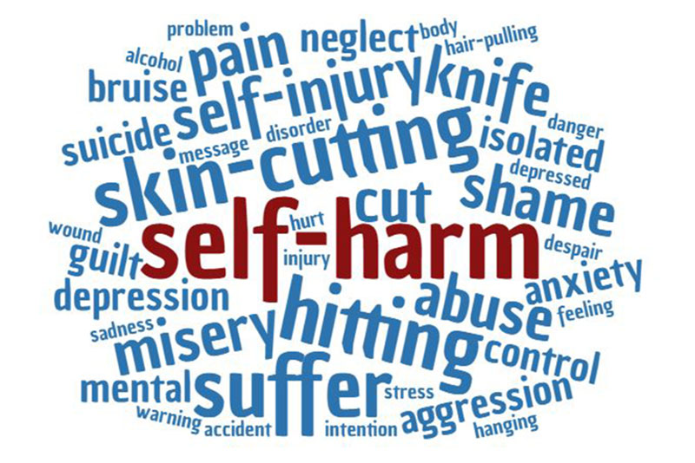
Myth Busters
Myth or Fact?
Self-Harm is only when you cut yourself?
Myth or Fact?
Only girls self-harm?
Myth or Fact?
Self-harm is a coping strategy?
Myth or Fact?
Self-harm is just a phase or emo?
Notes:
Self-Harm is only when you cut yourself? – Myth
Can take place in many forms – hurting or injuring yourself, poisoning yourself (drugs, alcohol, substance misuse – cannabis etc, overdose – prescribed or non-prescribed), doing something that will put your in danger such as getting in to fights or binge drinking, not looking after yourself – such as not eating meals or washing, sending hateful or abusive messages to yourself or about yourself online.
Only girls self-harm? - Myth
Any one can self-harm, no matter what their gender is.
More girls are seen by doctors or local services for self-harm, but that does not mean they are not the only ones that hurt themselves on purpose.
If boys self harm, they may feel judged or misunderstood.
Self-harm is a coping strategy? - Fact
Some people use self-harm as a way to cope with negative experiences, thoughts or feelings. They may feel that it is the only way for them to cope with the situation, or their feelings at that time.
However, self-harm is a negative coping strategy.
Self-harm is just a phase? - Myth
Someone may hurt themselves over a long period of time, a short period of time or even just once or twice. However long it lasts should not be ignored.

Slide 6
Myth or Fact?
If you self-harm, then you are suicidal?
Myth or Fact?
It is obvious when someone is self-harming?
Myth or Fact?
Self-harm is a mental health problem?
Myth or Fact?
You can stop self-harming?
Notes:
If you self-harm, then you are suicidal? – Myth
Not everyone who self-harms are thinking about ending their life.
Some people who self-harm also experience suicidal feelings, but it doesn’t always mean they want to die.
If someone is self-harming and they also feel suicidal, this is an emergency. An adult should call 999 to make sure they get the help they need.
It is obvious when someone is self-harming? – Myth
People who self-harm may keep it quiet for months or even years before telling someone or asking for help.
They may hide their self-harm because they are ashamed or worried about how others will react.
The way that some one self-harms may not leave obvious marks or signs either.
It is important to remember that it is nothing to be ashamed of. Keeping your self-harm a secret may stop you from getting the help you need.
Self-harm is a mental health problem? – Myth
Self-harm is not a diagnosis of a mental health problem. It is a behaviour that is often used to deal with difficult thoughts or experiences.
When someone hurts themselves, it could be linked to mental health problems. But on its own, it doesn’t mean someone has a mental health problem.
Treatment and support for self-harm may be through mental health services like CAMHS.
It is good to remember that mental health is about how we think, feel and act, and we all have mental health. Getting support for your mental health is a good thing, whether you have a mental health problem or not.
You can stop self-harming? - Fact
With all the right help and support, you can reduce your self-harm and then stop self-harming.
It may not be easy – the longer you have self-harmed, the longer it may take to break down your reliance on it and replace it with something safer.
Recovery from self-harm is a process and may be about managing the urge to self-harm, rather than stopping completely.

Slide 7
Why do People Self-Harm?
Living with health problems
Living with a mental health problem
Living with conditions such as ADHD or Autism
Stressful or upsetting experiences
Intrusive thoughts
Problems with how you feel about yourself
Seeing images of self-harm online
Drinking alcohol or taking drugs
Notes:
Living with health problems – like physical health or illness
Living with a mental health problem – or experiences linked with poor mental health like anger or hearing voices
Living with conditions such as ADHD or Autism
Stressful or upsetting experiences – like relationship problems, losing a loved one, bullying, abuse or money worries
Intrusive thoughts – thoughts that you don’t want to keep coming back to you
Problems with how you feel about yourself – like experiencing racism, homophobia, questioning your sexuality or identity, having low self-esteem or body image worries
Seeing images of self-harm online
Drinking alcohol or taking drugs

Slide 8
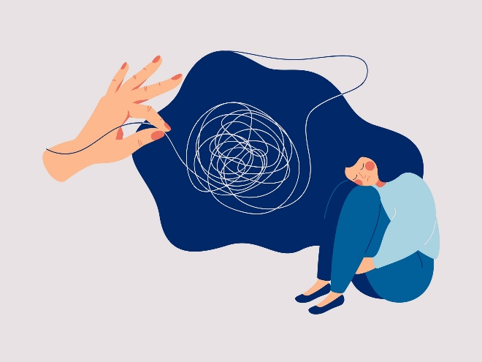
Distraction Techniques
Go for a walk or do some gentle exercise
Focus on your breathing
Text or call a friend
Listening to calming music
Write down your thoughts and feelings
Hit a cushion or a pillow
Tear up a magazine or a newspaper
Use some hand cream, rub gently in to your hands
Stroke a pet or something soft like a blanket
Paint or draw your emotions

Slide 9
Breathing exercises
Write up what is bothering you on a piece of paper and tear it up
Start a ‘positive statements about me’ diary
Have a bubble bath
Tidy up your bedroom
Squeezing a stress ball
Sleeping
Calling a helpline
Asking to spend time with your family
Helping someone else

Slide 10
School Nurse Actions
Quiet, confidential space
Discuss confidentiality with the young person
Liaise with parents/carers for consent to see the child and feedback any concerns
Share information with school as needed
Consider referral to school mental health provision or CAMHS
Follow-up appointment to be offered
Liaise with Safeguarding Lead of the school
If a young person tells us they are self-harming, we take it seriously and get them the help that they need straight away.
Notes:
- You will be seen in a quiet, confidential space to speak to the school nurse.
- Discuss confidentiality with the child/young person.
- As needed liaise with parents/carers for consent to see the child and feedback any concerns (school nurse to use clinical judgement of confidentiality and if there are safeguarding concerns and sharing of information with parents will put the child at risk).
- Share information with the school as needed (in line with safeguarding and data protection policies).
- Consider referral to school mental health provision or CAMHS.
- Offer follow up appointments with the child as appropriate
- Liaise with the Safeguarding Lead of the school
- If a young person tells us they are self-harming, we take it seriously and get them the help that they need straight away.

Slide 11
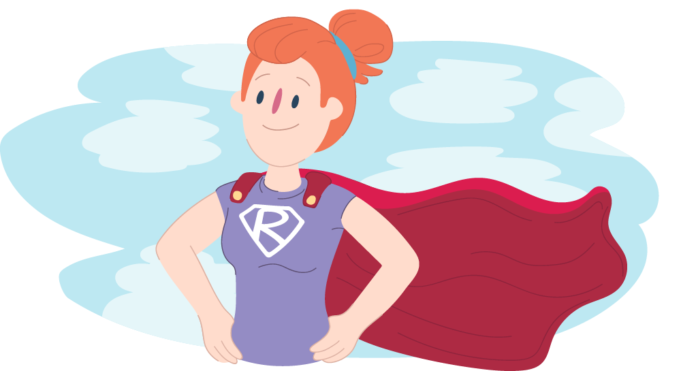
What is Resilience?
Resilience is the ability to cope when things go wrong. Resilience can also be described as: Bouncing back after difficult times, dealing with challenges.
Notes:
Ask the group ‘What is resilience’?
Allow the group to talk about resilience - They may have some of the answers.
Take about 4 or 5 examples and then tell them what resilience is – read out the definition on the presentation.
Resilience is the ability to bounce back from a negative experience or difficult challenge. ... Resilience is built by having confidence that you'll be able to get through or work around your problems, and by learning effective ways to cope with negative thoughts and emotions.
Why is it important to be resilient?
Let the group give a few answers.
Resilience is a brilliant asset to have.
Resilient individuals are more able to deal with difficulties and adversities than those with less resilience.
Evidence shows that resilience could contribute to healthy behaviours, higher qualifications and skills, better employment, better mental wellbeing, and a quicker or more successful recovery from illness.
When else will you need to be resilient in life?
Does it stop when you leave school?
Going through difficult times.
If you have good resilience what will that prevent?
Allow them to give 3-4 answers.
We will all need resilience – us, you, teachers, parents.
How do we get resilient?
The group need to understand that sometimes they are going to be anxious but they can develop resilience and reduce anxiety by planning, finding time to problem solve, taking a step back, talking to some one, deep breathing – that is resilience and is a life long strategy.
People who have the ability to become resilient, are less likely to have an identifiable mental illness when older and are also less likely to have emotional difficulties, financial hardship and difficulties in life.
Importance of resilience:
Young people need to understand that anxiety and stress are normal.
Everyone has stress and anxiety but it is how we cope with it.
These lessons that we learn when we are young will help us cope with life.
When you have exams/tests do you get stressed? – Managing exam stress will be discussed later.
Stress is normal but if you know what is going to be on the test you wont get stressed.
How can you reduce stress – look at work, revise, talk to other people about the content they have learned.
Stress is an old concept for us – because stress keeps us safe generally.
Discuss flight or fight.

Slide 12

How to Build Resilience
Think positive thoughts
Look after yourself
Keep trying
Talk to someone
Learn from mistakes
Work towards your goals
Look for the positives in the situation
Accept that change happens all the time
Accept that negative things can happen
Improve your problem solving skills
Find things that help you feel calm
Get help when you need it
Notes:
Taking steps to look after your wellbeing can help you deal with pressure, and reduce the impact that stress has on your life. This is sometimes called developing emotional resilience.
Resilience is not just your ability to bounce back, but also your capacity to adapt in the face of challenging circumstances, whilst maintaining a stable mental wellbeing. Resilience isn't a personality trait – it's something that we can all take steps to achieve.
Accept that change happens all the time – examples are: going to school and expecting to see your teacher but a supply teacher is in place. You best friend been absent from school. Transitioning from primary to secondary school.

Slide 13
Things that can Develop Resilience
Some things that can help develop resilience are:
Having a positive attitude
Finding good friends
Feeling good about yourself
Feeling like you belong
Having a supportive family
Helping others or 'giving back'
Being able to solve problems and overcome challenges
Good communication with the people around you
Notes:
Once you have had long discussion on resilience, ask the group how you can develop resilience?
Give them some of the answers from the presentation.
For example you can:
Make some healthy lifestyle changes:
Practise being straightforward and assertive in communicating with others - If people are making unreasonable or unrealistic demands on you, be prepared to tell them how you feel and say no.
Use relaxation techniques - You may already know what helps you relax, like having a bath, listening to music or taking your dog for a walk. If you know that a certain activity helps you feel more relaxed, make sure you set aside time to do it.
Develop your interests and hobbies - Finding an activity that's completely different from the things causing you stress is a great way to get away from everyday pressures. If stress is making you feel lonely or isolated, shared hobbies can also be a good way to meet new people.
Make time for your friends - When you've got a lot on this might seem hard, but it can help you feel more positive and less isolated. Chatting to friends about the things you find difficult can help you keep things in perspective – and you can do the same for them. Laughing and smiling with them will also produce hormones that help you to relax.
Look after your physical health:
Get enough sleep - Stress can often make it difficult to sleep, and can cause sleep problems. Getting enough sleep can help you feel more able to deal with difficult situations.
Be active - Being physically active is important for both our physical and mental health. Even making small changes such as going for a regular walk outside may help you to feel less stressed.
Eat healthily - When you're stressed, it can be tempting to skip meals or eat too much of the wrong kinds of food. But what you eat, and when you eat, can make a big difference to how well you feel.
Give yourself a break:
Reward yourself for achievements – even small things like finishing a piece of work or making a decision. You could take a walk, read a book, treat yourself to food you enjoy, or simply tell yourself "well done".
Get a change of scenery - You might want to go outside, go to a friend's house or go to a café for a break – even if it's just for a short time.
Resolve conflicts, if you can - Although this can sometimes be hard, speaking to a manager, colleague or family member about problems in your relationship with them can help you find ways to move forward.
Forgive yourself when you feel you have made a mistake, or don't achieve something you hoped for. Try to remember that nobody's perfect, and putting extra pressure on yourself doesn't help.
Build your support network - Remember that whatever you're going through that's causing you stress, you don't have to cope with it alone
Friends and family - Sometimes just telling the people close to you how you're feeling can make a big difference – and they might be able to help you out in other ways too.
Peer support - Sometimes sharing your experiences with people who've been through something similar can help you feel less alone.
Support at School or College - For example, this could be from your tutors, student union or student services.

Slide 14

Everyone can Learn to be Resilient
Learning to build resilience can help you feel stronger
Learning to build resilience can make problems easier to deal with in the future.
Notes:
You don’t just need resilience in school, you need it every day.
Resilience will help you to pass exams or get a place at University.
Adults also need to be resilient.
Examples of being resilient – many years ago, I applied for a job but did not get it. I reflected on why I did not get the job and used a different approach. Lots of job opportunities out there.
Would any one like to provide an example of when they have been resilient?

Slide 15
Managing Exam Stress
Notes:
Tips for managing exam stress
Start off by asking them what they think they could/can do avoid, or cut down on stress prior to exams before going through the slides.

Slide 17
Mental Health Support for Young People
Kooth – www.Kooth.com Online anonymous support. The online chat to professionals runs from 12pm-10pm on weekdays and 6pm-10pm on weekends
Papyrus – Help line runs from 9am-midnight every day, 0800 068 4141
Childline - 0800 1111 there is also an online chat support, both have qualified counsellors. They also have a BSL video chat option for children who are deaf or hearing impaired
The Mix - Call 0808 808 4994
Notes:
Let students know that it can be very common to experience ups and downs throughout life, but it is always good to talk about it to friends and trusted adults and there are lots of organisations that can give support such as Childline, or the Mix which run free telephone helplines for children and young people. Shout 85258 is a free, confidential, 24/7 text messaging support service for anyone who is struggling to cope.
Kooth Online Mental Health Service - online counselling service aimed at supporting students with a range of emotional issues. Students are able to chat to the helpful team about anything that’s on your mind. Message or have a live chat or Start or join a conversation with the friendly Kooth community - Lots of topics to choose from!
You could also remind students of school support services they can access, such as their tutor or school counsellor or the school nursing service.

Slide 18
Young Minds – 24/7 Free texting service. Text YM to 85258 texts are answered by trained volunteers. If they think a child or young person is at risk they will share details with someone who can help.
Shout – 24/7 free crisis text service 85258
Samaritans - 24/7 free confidential help line 116 123
Calm Harm – https://calmharm.co.uk/ - This is app designed to distract young people from self-harm. It’s NHS approved and can be useful for distraction techniques.
Notes:
If you are going to take anything away from today, just remember it is completely normal to feel anxious and stressed for short periods of time and this can happen many, many times.
If you find that even though you feel you have built resilience and have been dealing with your anxiety well, and you suddenly feel overwhelmed, you can ask for support whether that be from the school or our service which the school can arrange.
The PowerPoint presentation will be shared with and this can be used this as a reference.

Slide 19
https://www.selfharm.co.uk/ - 8 week courses for young people aged 14-19 struggling with self-harm.
www.clearfear.co.uk – An app to help children and young people manage the symptoms of anxiety.
www.movemood.co.uk – A free app to help teenagers manage low mood and depression.
Tootoot – Online reporting platform which promotes pupil voice and provides students with an alternative method of disclosing concerns or worries in a discrete and confidential way. The school safeguarding team are alerted instantly when a disclosure is made and the next steps are put in to place.

Slide 20
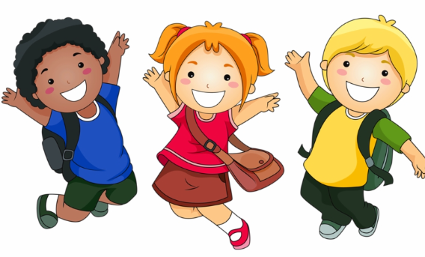
Any Questions?
Notes:
Thank you for listening.
Any questions?

