Slide 1

Welcometo
GNSASixthform
Become the author of your own adventure

Slide 2

Why does the eye see a thing more clearly in dreams than the imagination when awake?
Leonardo da Vinci

Slide 3
Our Vision
‘A sixth form that is dedicated in providing outstanding pastoral care that supports academic progress, enriches student life and develops well rounded citizens that are able to make their way in life and contribute to society’.
What we do?

Slide 4
MEET THE TEAM
Mr Sidhu
Mrs Kaur
Assistant Principal
Progress Leader & Coaching for Learning and Attainment
---
---
Our Goal
For all students to achieve their ALIS target grade in all subjects
Enriching student life and developing well rounded citizens who are able to make a significant contribution to society;

Slide 5

Rework

Slide 6
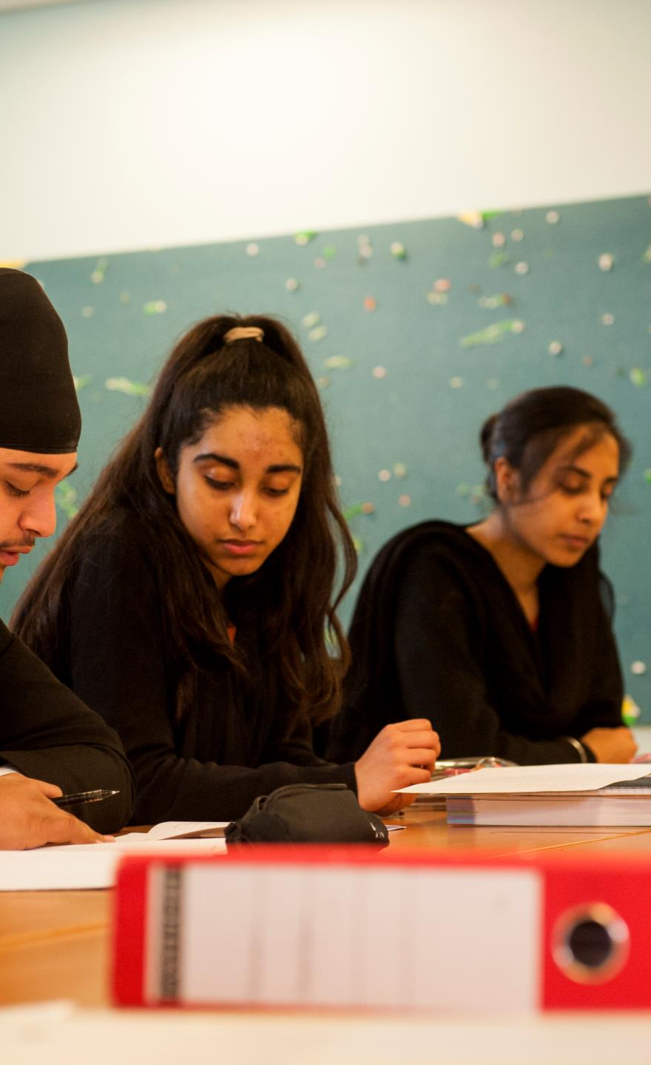
OurStrengths

Academic
In past 3 years our value added score has gone up significantly

Intake: Choice of most of the HAP students

Enrichment

Ethos

UCAS Program

Behaviour

Slide 7
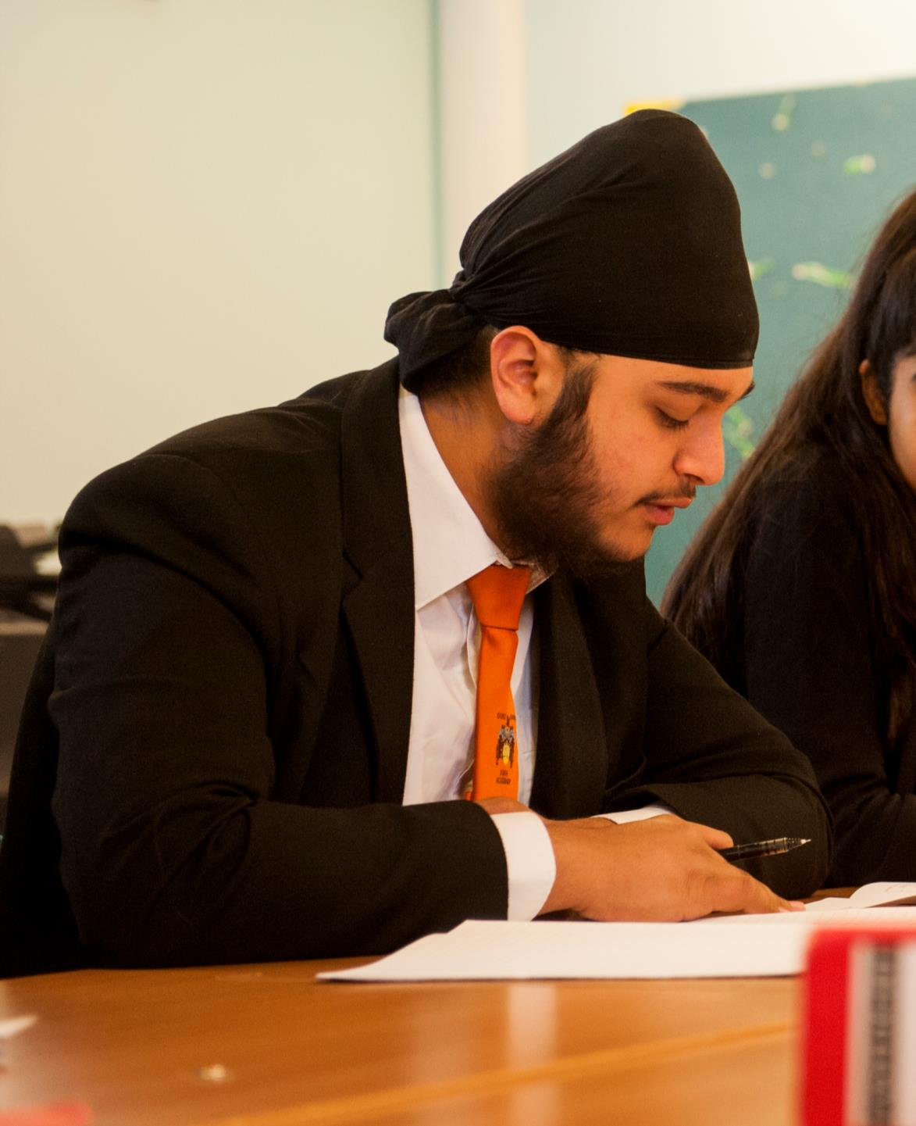
Our Destinations
UCL
City University
Brunel University
Reading University
Aston University
Roehampton University
Queen Mary University
Kingston University

Slide 8
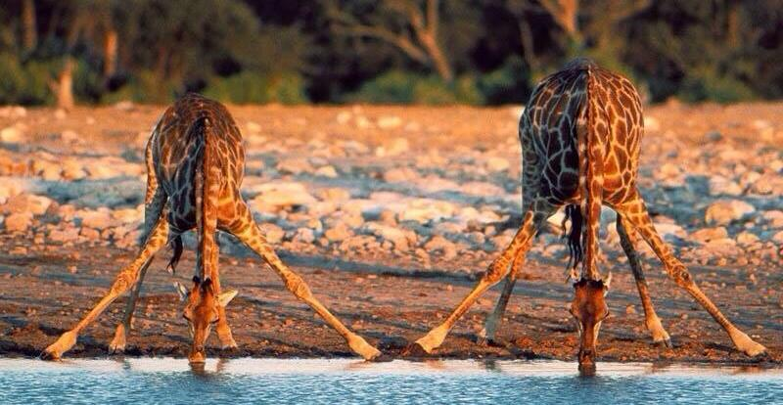
WHATwedo?
If the solution is simple, God is answering.
Albert Einstein

Slide 9

They are not children, they are professionals
REINVENT
Independent Learners
Professionals
100% commitment
Responsibility and accountability
Clear pathway to success - Universities
Embrace technology
Participate in all activities
Positive Mind-set

Slide 10
Howdowegetthere?
“Direct one’s hopes towards achieving something”
A
S
P
I
R
E

Slide 11
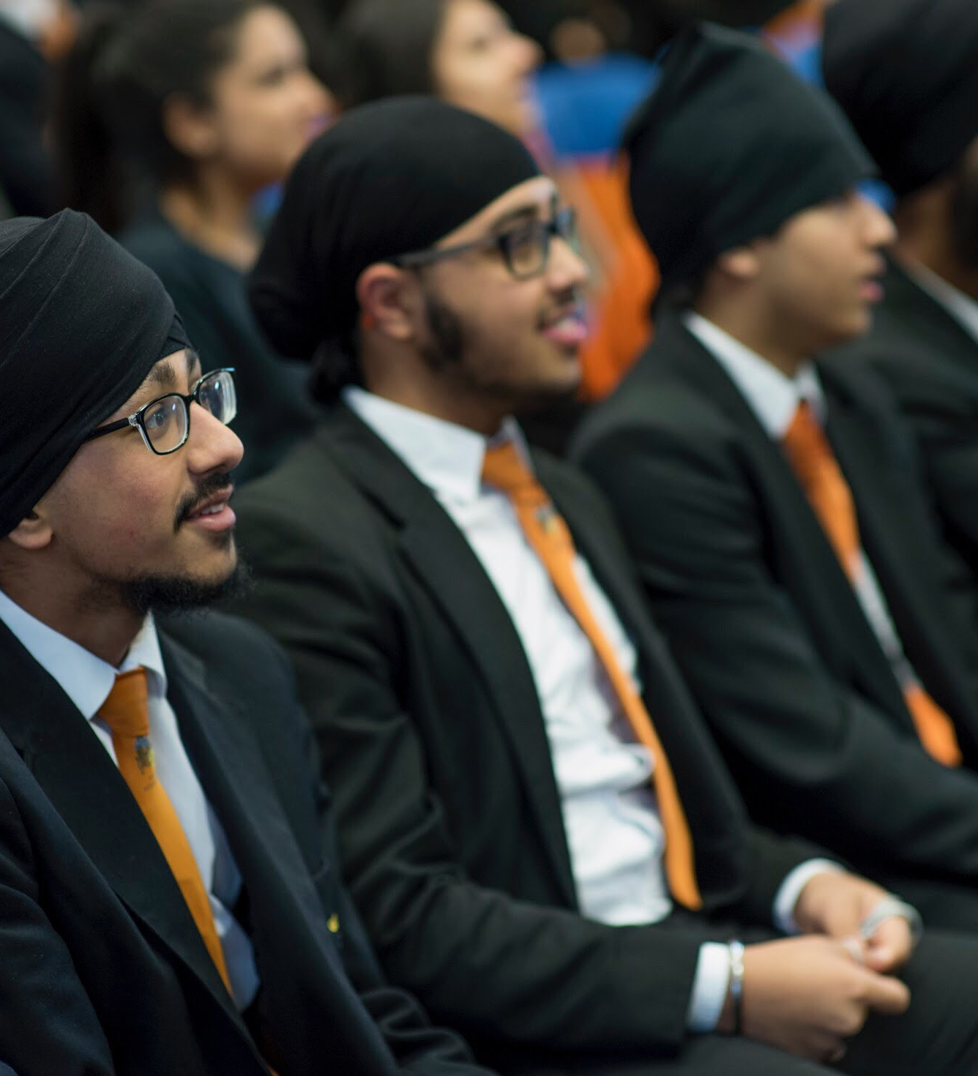
Forms
HOW?
VI
Pankhurst – VIP (VIGT) – Miss N Pal
Harvey – VIH (VIPB)– Dr P Bhullar
Brunel – VIB (VISS)– Miss S Sidhu
Franklin – VIF (VISB) – Mr I Bissix
Austen – VIA (VINS) – Mr M Kalloor
Seacole – VIS(VISA) – Mr M Alahyan

Slide 12
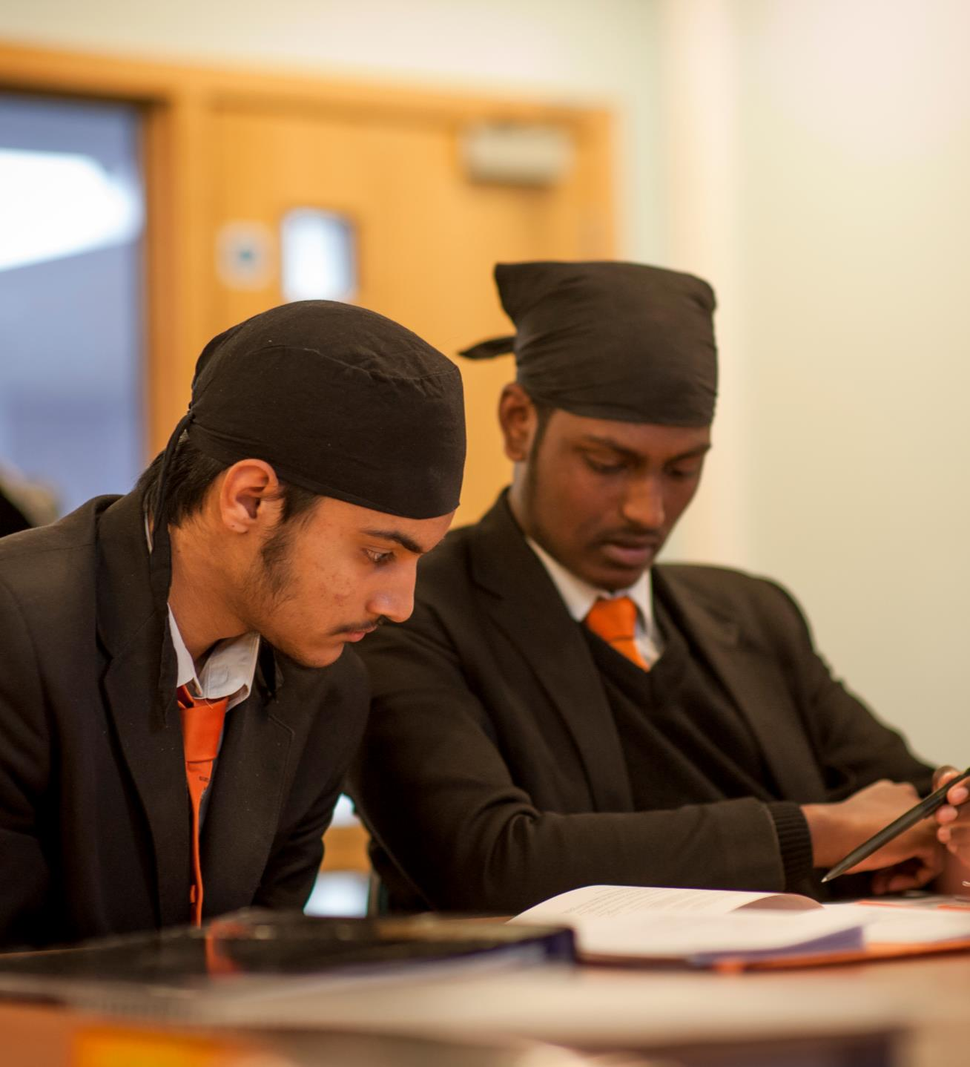
Coaching
HOW?
VI
For Learning
Growth Mind set – ‘CAN DO ATTITUDE’
Students assigned a Coach
Personalised Learning Checklist
Independent Learning Checklist
Coaching conversation
Collect evidence
Meeting to showcase your work
Renew or revisit
Repeat the cycle (3 cycles over the year)
Subject interventions

Slide 13
Targeted intervention
ALPS predicted grades
UCAS predictions (ALPS/AS grades)
3 assessment cycles
Challenging underperformance through coaching sessions
Notes:
GK

Slide 14
Enrichment
S.W.A.T | Christmas dinner & dance
Mock interviews | Break & lunch duties
UCAS conference | Educational trips
Work experience | Guest speakers
Classroom assistance | Public speaking competition
Religious events | PSHE community projects
Parent’s evening | LAMDA
Bowling | Beck Theatre
Film & Food | Head Girl & Head Boy
VI quiz night | ???????????

Slide 15
Time spent - Grade Achieved
Grade | Independent study – outside the classroom
A*/A | 35 + hours a week
B | 25 – 35 hours a week
C | 15 -25 hours a week
D | 10 – 15 hours a week
E | 5 – 10 hours a week
Non – contact time in school is approximately 7 hours a week

Slide 16
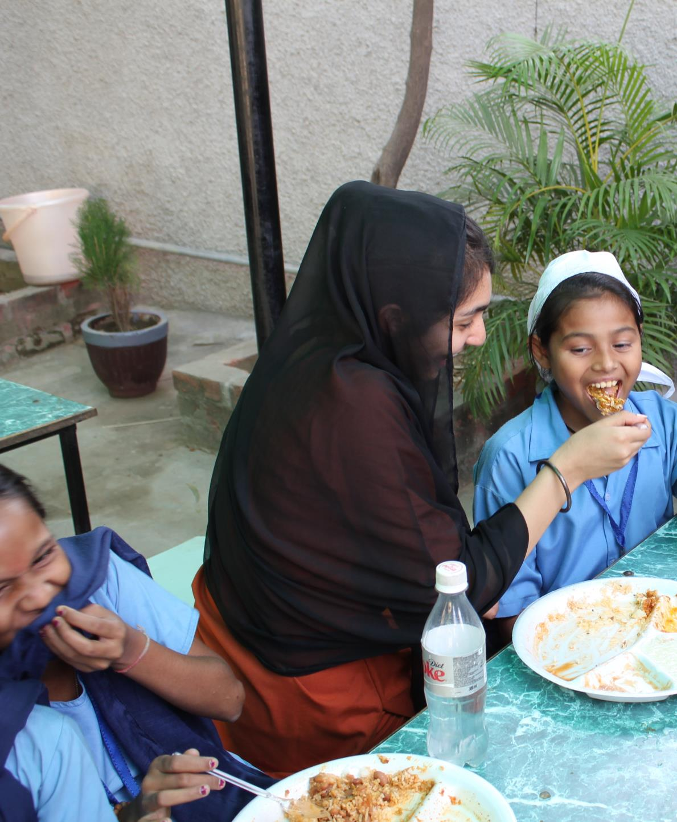
Life Skills
First Aid
Charity work
Mock interviews
Public speaking
Coaching – Classroom support
Sewa – SWAT, Cancer research, Children in need

Slide 17
Enrichment courses
Extended Project Qualification
LAMDA
Duke of Edinburgh
MOOC (subject based)

Slide 18
Changes in A Levels
Linear examination
No external assessment at the end of Year 12
External assessment at the end of Year 13 in 2019

Slide 19
Advice for parents

Slide 20

Teenagers need support on their own terms – be open to their ideas and how they want you to help them

Slide 21

Look for opportunities to open up discussions on issues or subjects

Slide 22

Ask Question

Slide 23

Research

Slide 24

We are here to help

Slide 25

Always remember how they achieved this place

Slide 26
Look out for…
Progress reports
3 reporting cycles
Settling in evening – Thursday 16th November
Celebrating success evening (December)
Mock exams (December)
Pre-public exams (March)
End of year internal assessment (May/June)
Enrichment events

Slide 27
Importance of work experience
Very important for UCAS forms
  The more interesting the placement the better
Essential if you are planning a career in Veterinary, medical, teaching and similar career areas
Chance to try something out
  Does it suit me?
  Do my skills and abilities fit this type of work?

Slide 28
Importance of work experience
Opportunity to make contacts for possible;
  future employment
  part time job
  Sponsorship
Opportunity to find out more about that area of work
  What opportunities are there for progression?
  What qualifications are important?
  What additional training might be needed?

Slide 29
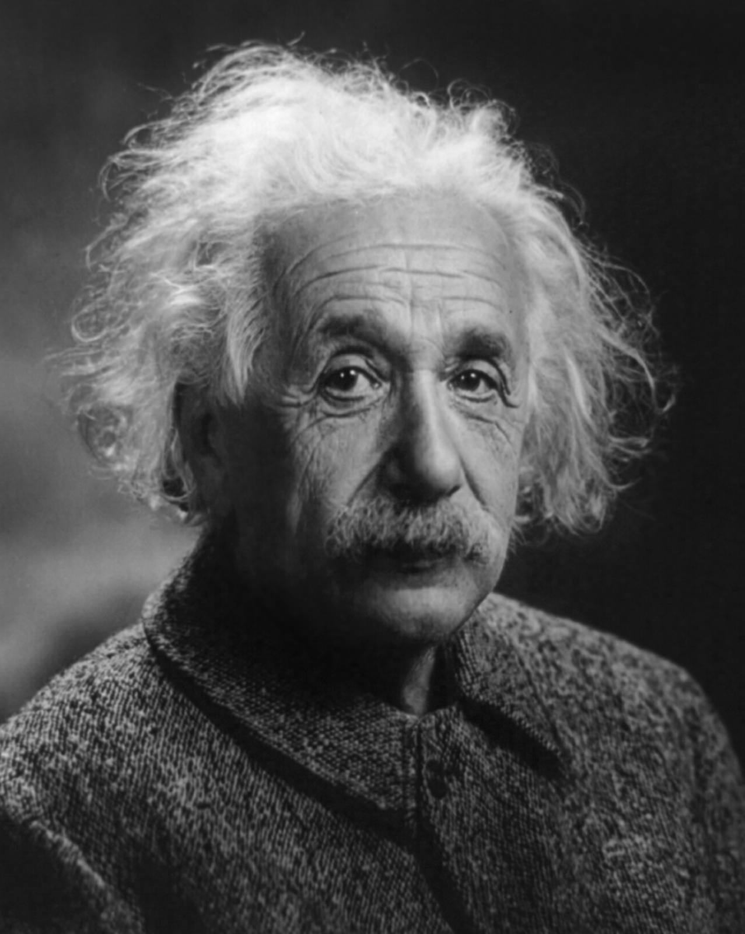
“The only reason for time is so that
everything doesn't happen at once.”
Albert Einstein

Slide 30
Any questions?

